Slide 1
The Future of IT All
Rolando Hernandez
Enterprise Rules Architect
CEO, BIZRULES
RH.2008@BizRules.com
www.BizRules.com
www.VisibleKnowledge.com

Slide 2

The Future of IT All is…
Comply
WITH CONSTANTLY
CHANGING REGULATIONS
Sustain
Architect
A KNOWLEDGE-BASED
WORLD
SYSTEMS THAT WORK,
CHANGE, AND LAST
Prevent
BUSINESS MISTAKES
Automate
Align
KNOWLEDGE WORK
IT SYSTEMS
WITH BUSINESS STRATEGY
Leverage
RULE-BASED AND KNOWLEDGE-BASED SYSTEMS
AND STOP ‘HARD-CODING’ DATA-BASED SYSTEMS
Modernize
LEGACY SYSTEMS
Retain & Share
THE KNOWLEDGE OF
RETIRING BABY BOOMERS

Slide 3


















The Future of IT is… Aligning IT Systems with Business Strategy
?
The Future of IT All is…
INTELLIGENCE
Answering
?
QA Technology
Answer Engine
KNOWLEDGE
IT - Intelligent Technology
ONLINE DECISION PROCESSING (OLDP)
Searching
Decisioning
Advising
Complying
Recommending
Scheduling
Optimizing
Diagnosing
Troubleshooting
Business Intelligence
A.I. Artificial Intelligence
Real-Time Decisioning System
BPM & BRM
Business Rule Mgmt System
Web Browser
Search Engine (Google)
INFORMATION
IT - Information Technology
ONLINE ANALYTICAL PROCESSING (OLAP)
Analyzing
Warehousing
Decision Support
Mining
Decision Support
Multidimensional Database
CRM & SCM
Knowledge Management (KM)
Business Rule Engine (BRE)
Knowledge Base
Windows (Microsoft)
WWW URL HTTP
DATA
MIS - Management
Information Systems
ONLINE TRANSACTION PROCESSING (OLTP)
Transacting
Reporting
Networking
Relational Database
Client/Server LAN
Object-Oriented Systems
Expert System (ES)
Rulebase
DP - Data Processing
BATCH DATA PROCESSING
Accounting
Automating
Magnetic Tape/Flat File
Hierarchical Database
COBOL
Internet e-Mail
Mainframe Era
1970’s
PC Revolution
1980’s
World Wide Web
1990’s
2000’s
Wireless Web
Smart Phone
Semantic Web
2010’s
?
INTELLIGENT SYSTEMS
KNOWLEDGE-BASED SYSTEMS
Complex rules; Deep/narrow scope of reasoning
RULE-BASED SYSTEMS
Simplistic, Externalized, Declarative Rules; Shallow/broad scope of reasoning
DATA-BASED SYSTEMS Rules hard-wired in code, stored procedures, or triggers
Copyright © 2008 BIZRULES

Slide 4
The Future of IT = Data + Rules + Knowledge
 | Data-Based System | Rule-Based System | Knowledge-Based System
Can process | Data | Data Rules | Data Rules Knowledge
Can output | Information | Information Decisions Real-Time Decisions | Information Decisions Answers Expert Advice Recommendations
Commonly implemented using | “Hard-coded rules” Procedural languages | “Rule-based” Declarative languages Deterministic | Fuzzy Logic, CBR, Probabilistic reasoning, other AI/ES techniques
Ideal for | IT/System rules Application rules | Simplistic business rules | Complex business rules
Best for these types of applications | Transacting Reporting (Traditional information systems) | Decisioning Compliance | Advising Product selection Recommending Troubleshooting
Intelligence Capability | Not intelligent | Shallow logic Broad domains | Deep Logic Narrow domain

Slide 5


















The Future of IT is… separating Rules from Code & Data
Applications
CODE
Applications
Rules Engine
RULES
CODE
RULES
Applications
Database Engine
Database Engine
DATA
RULES
CODE
DATA
DATA
Operating Environment
Operating Environment
Operating Environment
Classic
Current
Emerging
Notes:
Copyright 2002 (c) BizRules.com

Slide 6
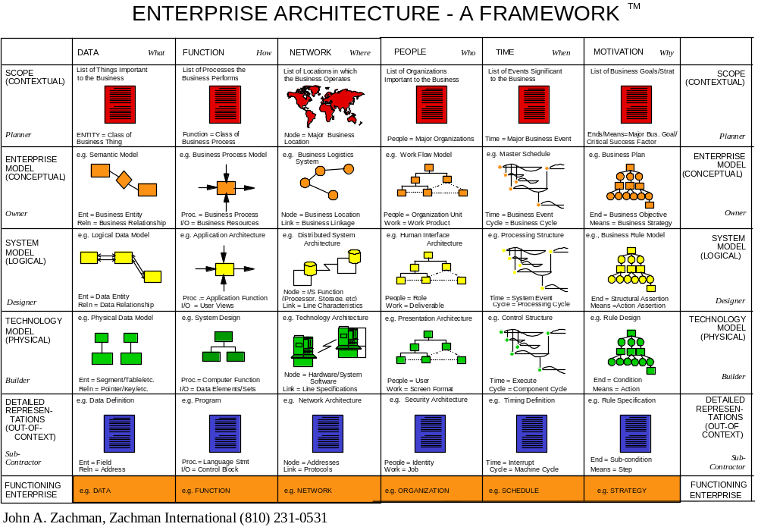
The Future of IT is… separating rules, code, data, and processes
Enterprise Architecture – A Framework
TM
Enterprise Architecture – A Framework™
©John A. Zachman, Zachman International (810) 231-0531
Reprinted by permission – www.zifa.com

Slide 7
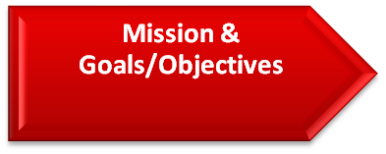

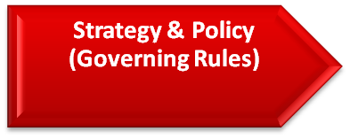

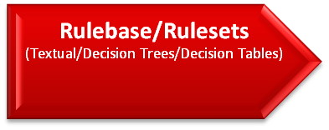

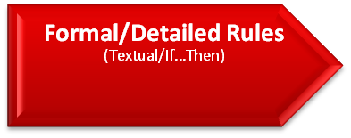

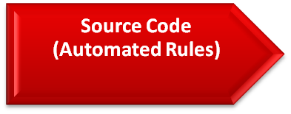


The Future of IT is… Aligning IT Systems with Business Strategy
Management Intention
Informal or Detailed Description
Detailed Logical Definition
Detailed Technical Specification
Implementation
Enterprise Decision
Enterprise Architecture – A Framework™
©John A. Zachman, Zachman International (810) 231-0531
Reprinted by permission – www.zifa.com

Slide 8
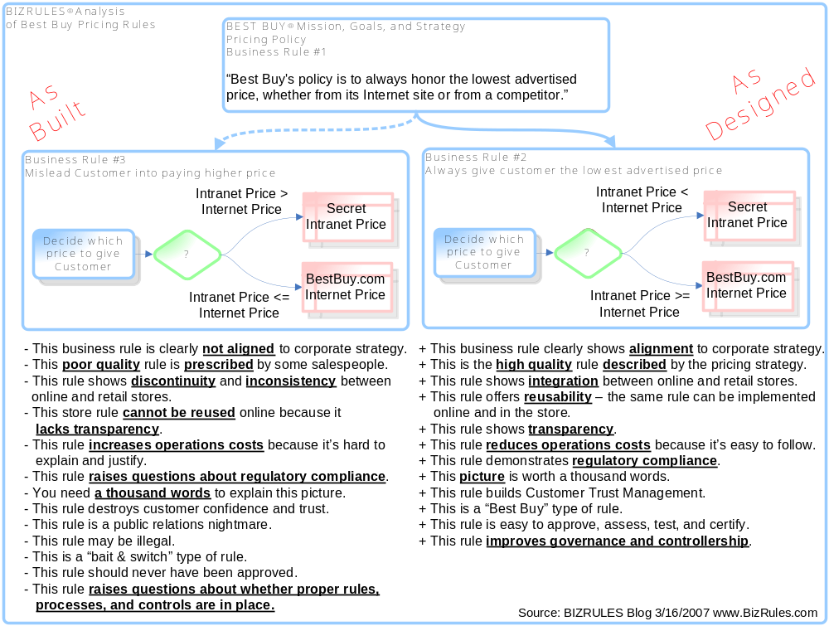
The Future of IT is… Preventing Business Mistakes

Slide 9



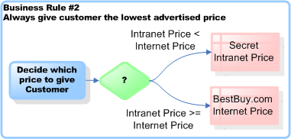


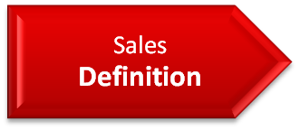
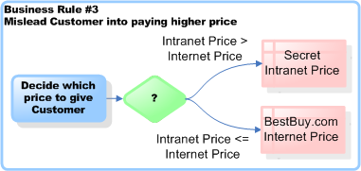


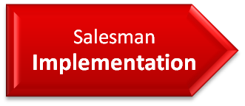

The Future of IT is… Aligning Decisions with Rules, Policies and Regulations
TM
Policy is
Clear
Policy is
Clear
Unknown
Under
investigation
Unknown
Under
investigation
Salespeople decide which price to give customer
Enterprise Architecture – A Framework™
©John A. Zachman, Zachman International (810) 231-0531
Reprinted by permission – www.zifa.com

